Slide 2
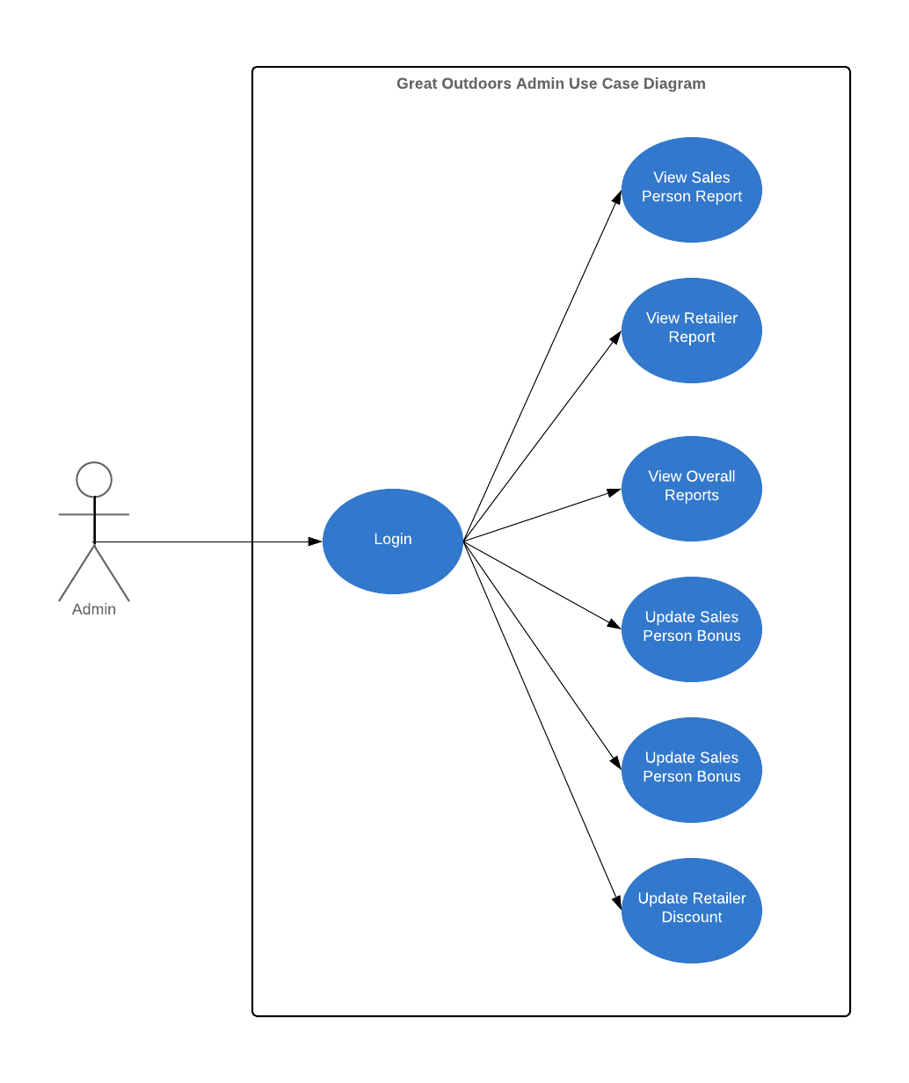

Slide 3
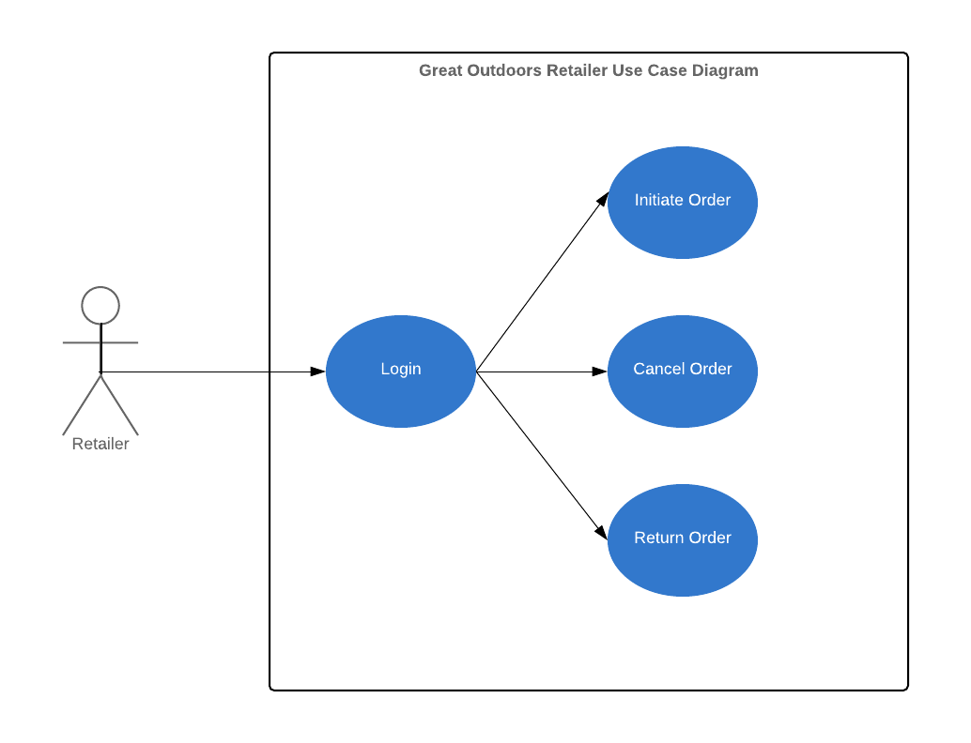

Slide 4
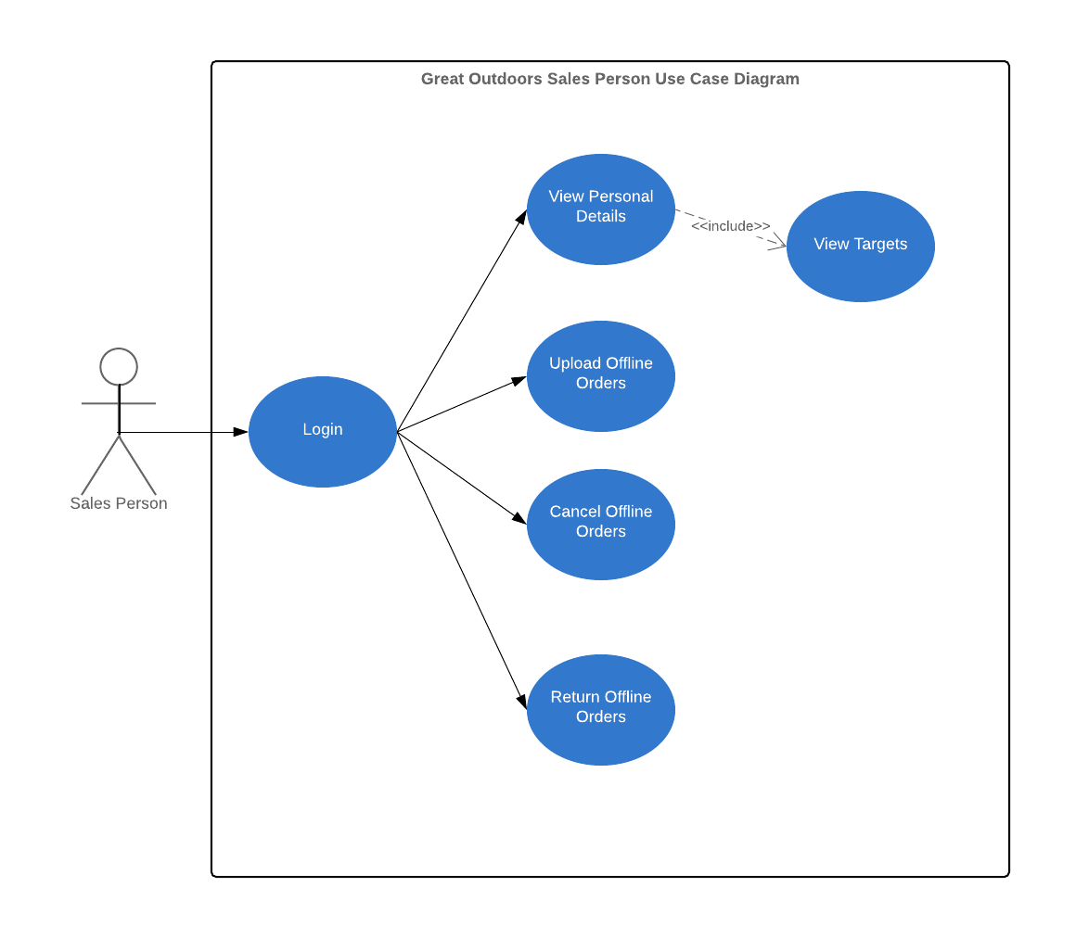

Slide 5
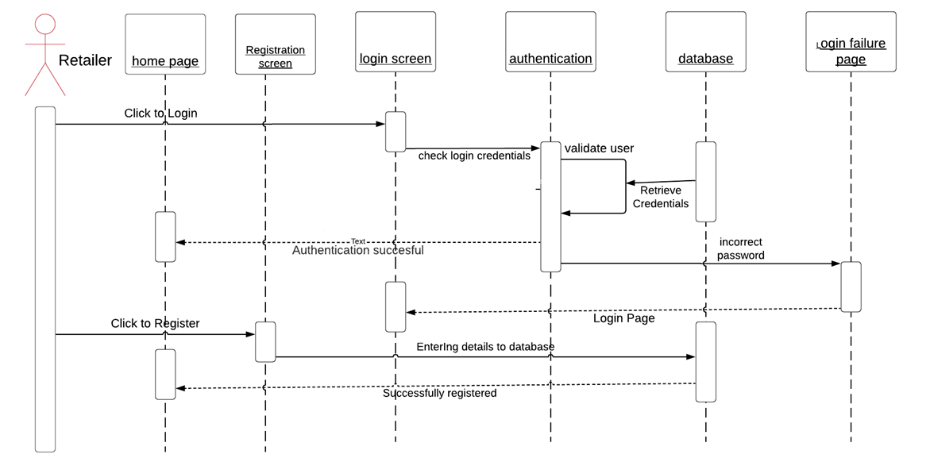
Sequence diagram for Retailer Login

Slide 6
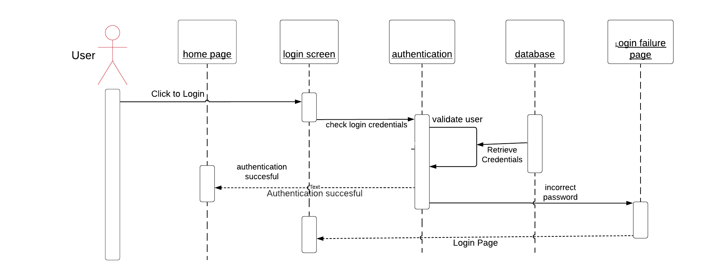
Sequence diagram for Admin and Sales Person Login

Slide 7
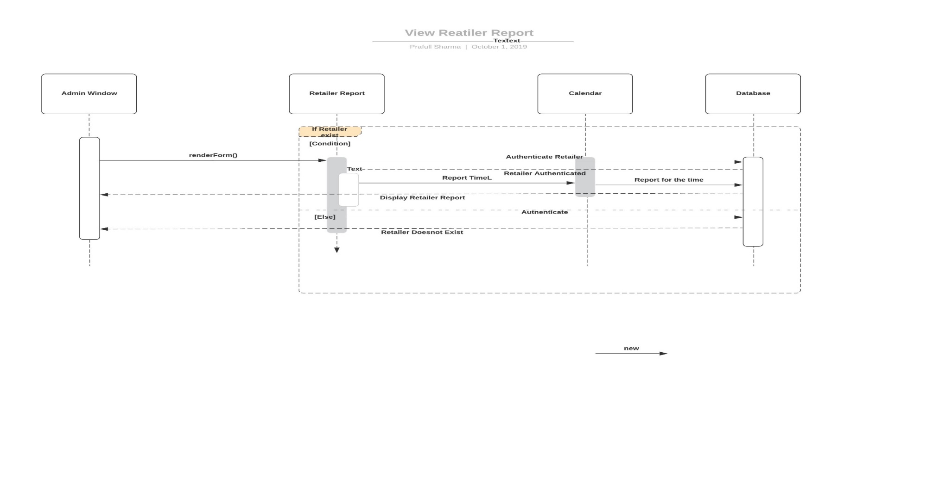
Sequence Diagram for Retailer Report

Slide 8
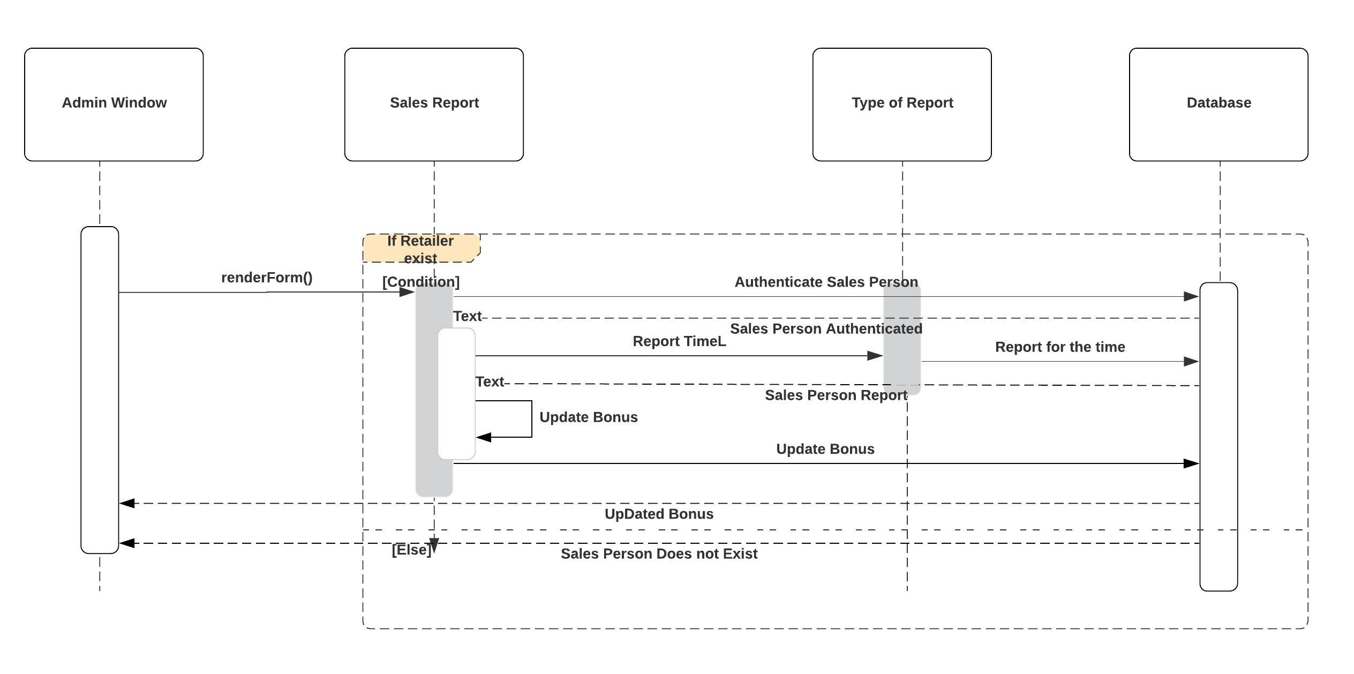
Sequence Diagram for Update Bonus

Slide 9
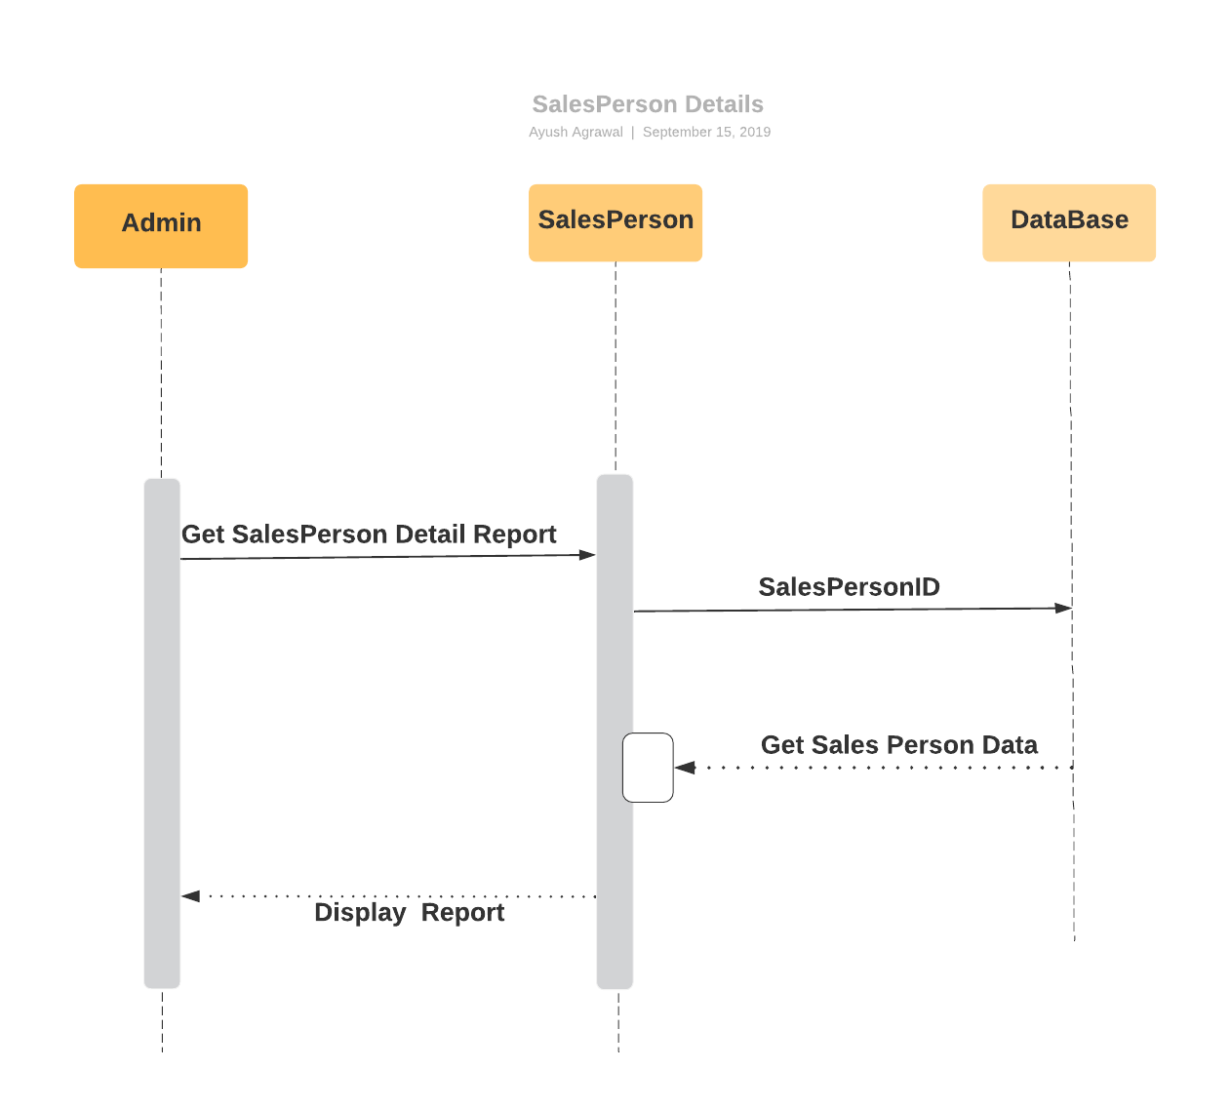
Sequence Diagram for Sales Person Details

Slide 10
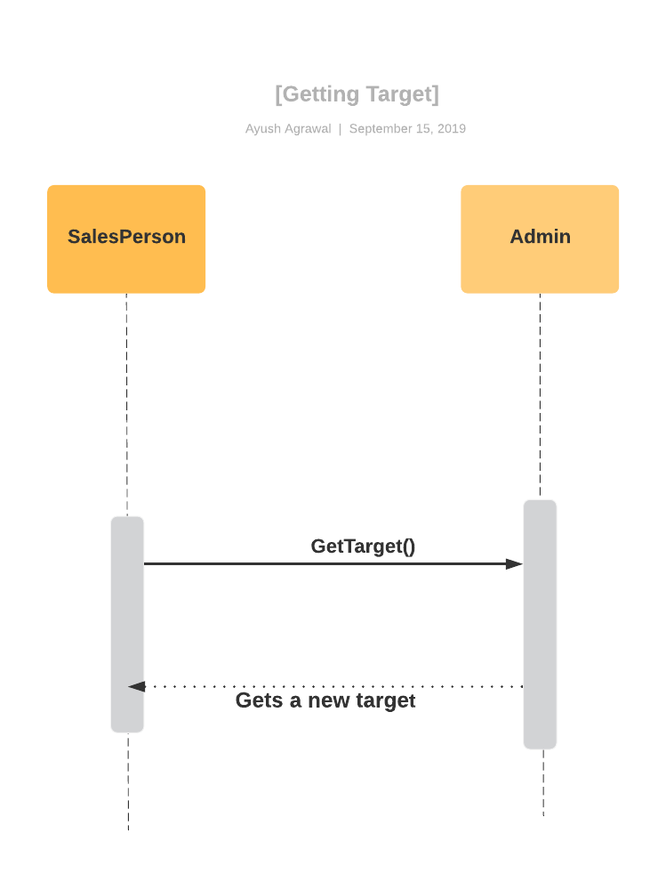
Sequence Diagram For Getting Sales Target By Sales Representatives

Slide 11
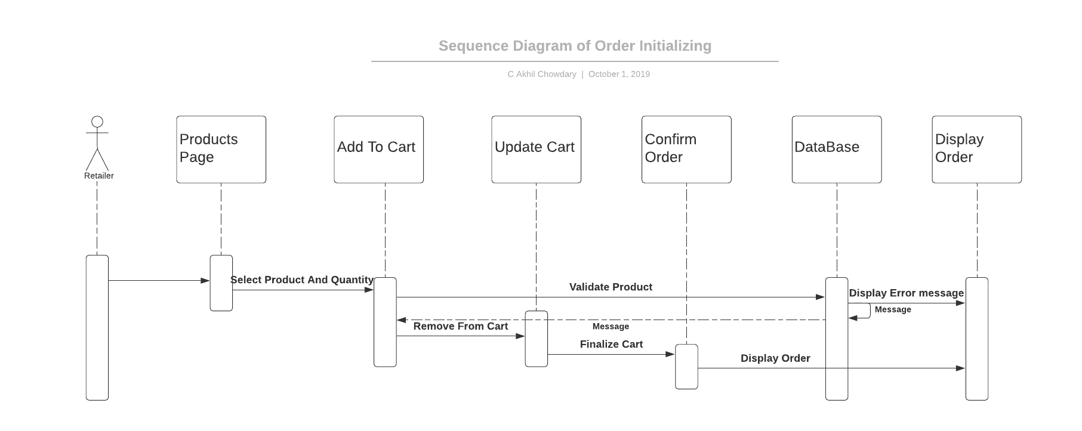
Sequence Diagram For Order Initializing

Slide 12
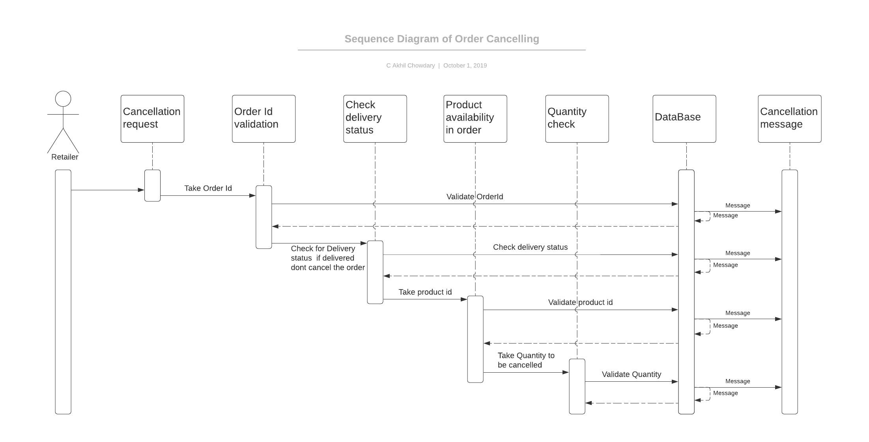
Sequence Diagram For Online Cancel

Slide 13
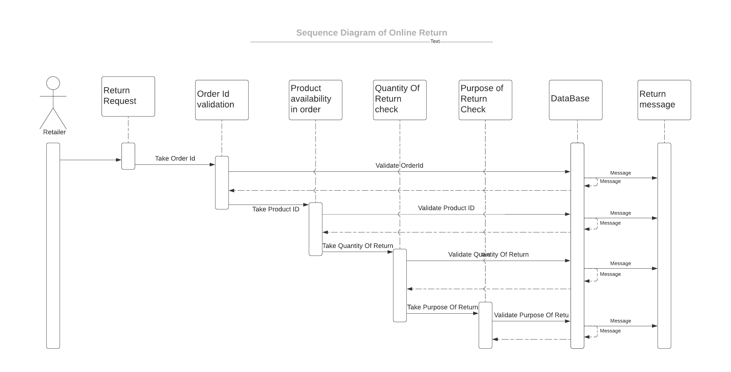
Sequence Diagram For Online Return

Slide 14
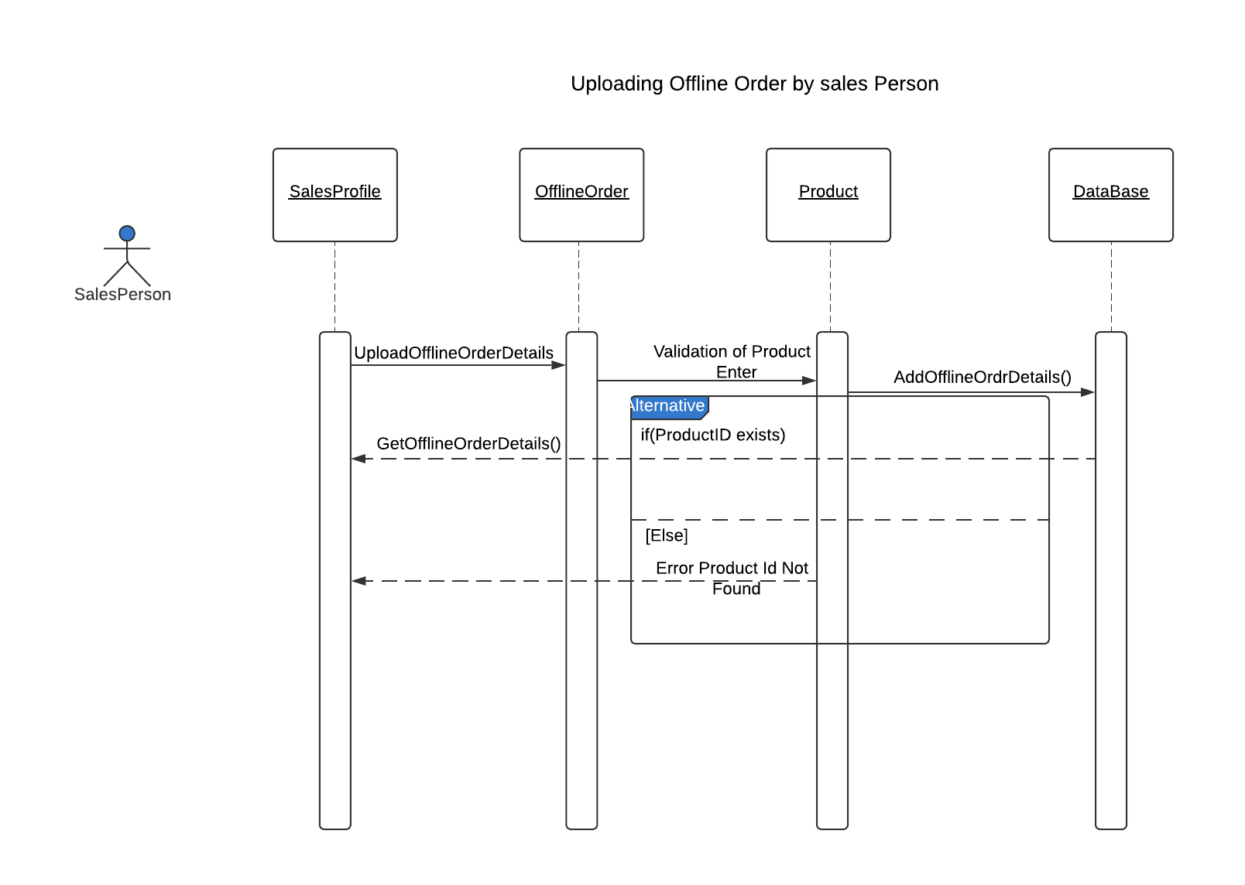
Sequence Diagram For Uploading OfflineOrder

Slide 15
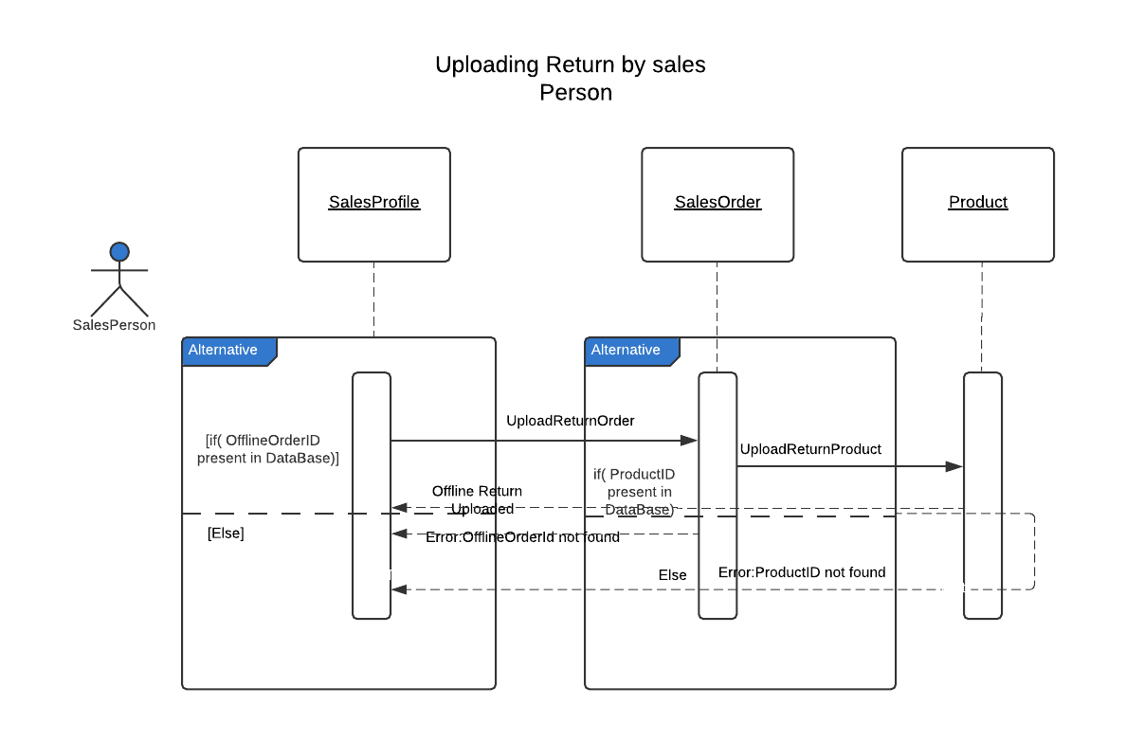
Sequence Diagram For Uploading Return By SalesPerson

Slide 16
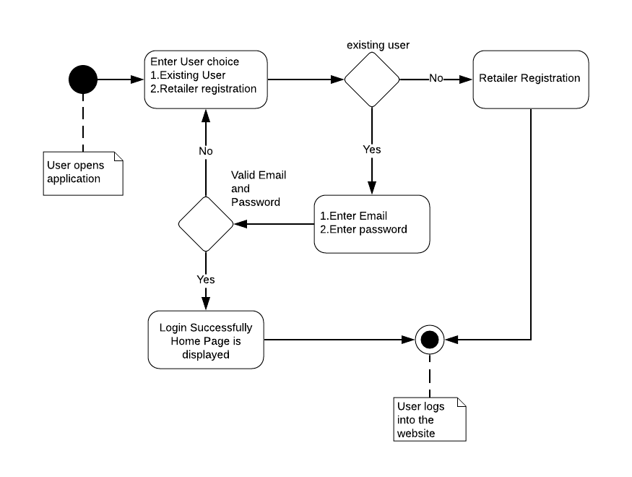
Activity diagram of Login

Slide 17
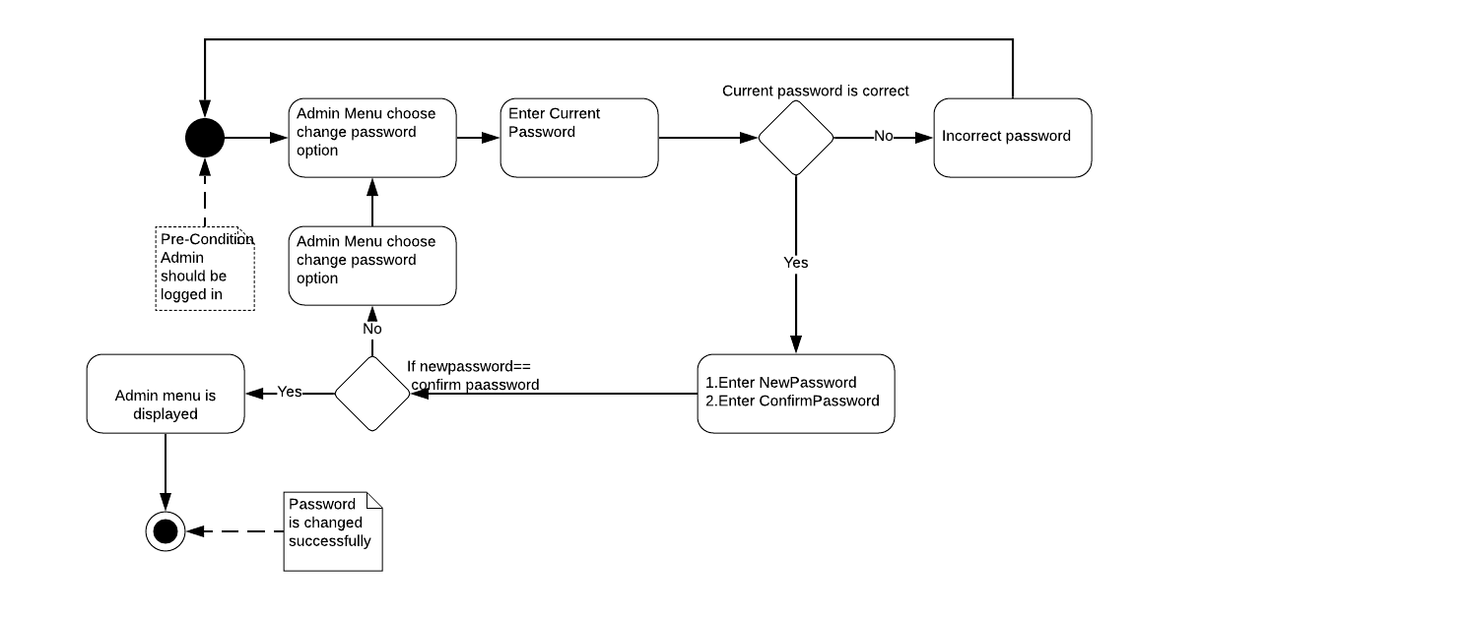
Activity diagram of Changing Admin Password

Slide 18
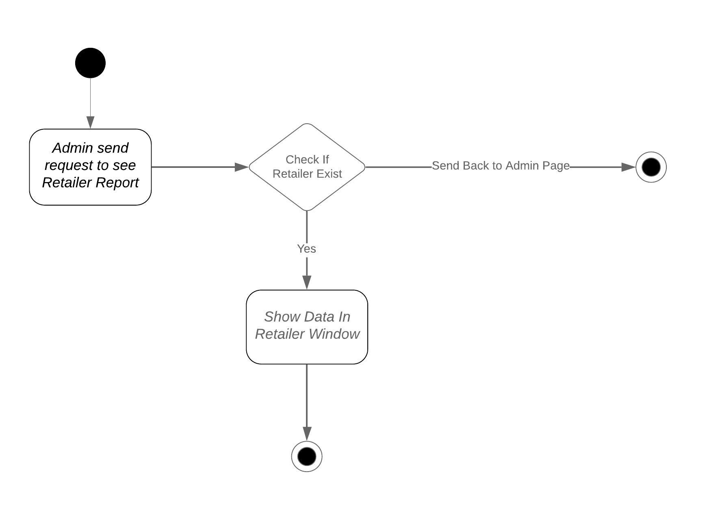
Activity Diagram For Retailer Report

Slide 19
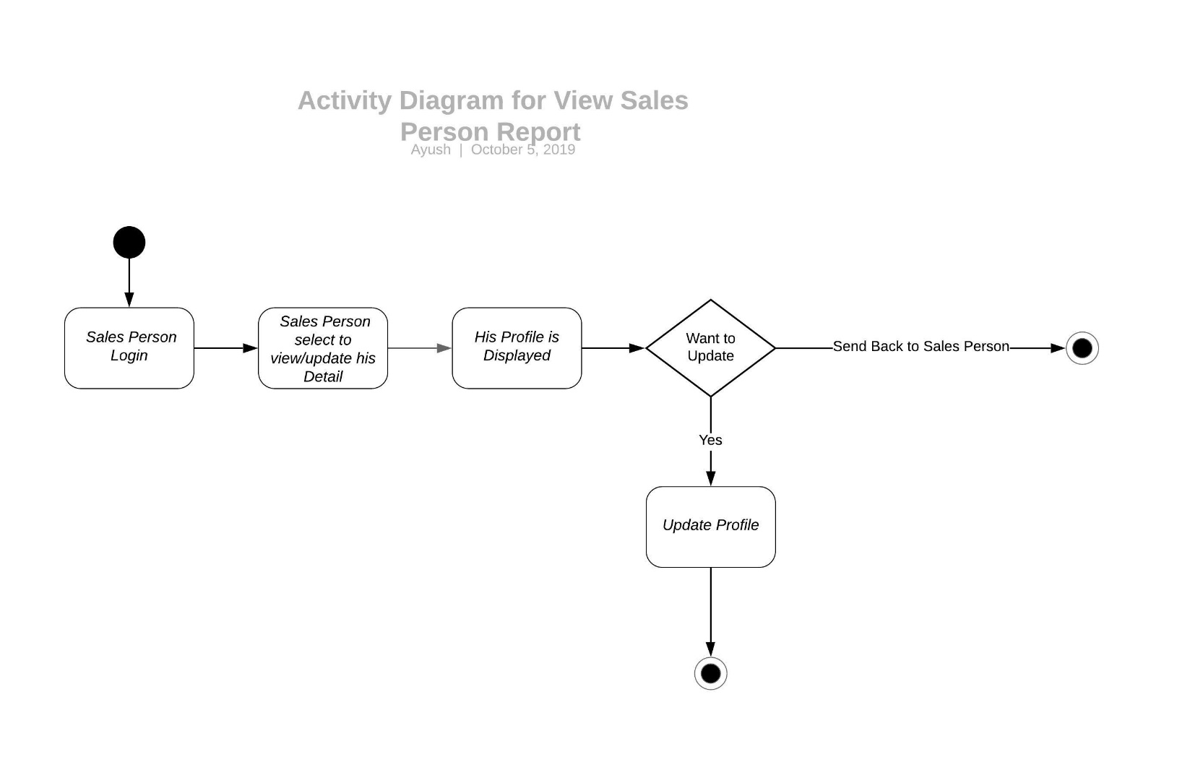
Activity Diagram For Sales Report

Slide 20
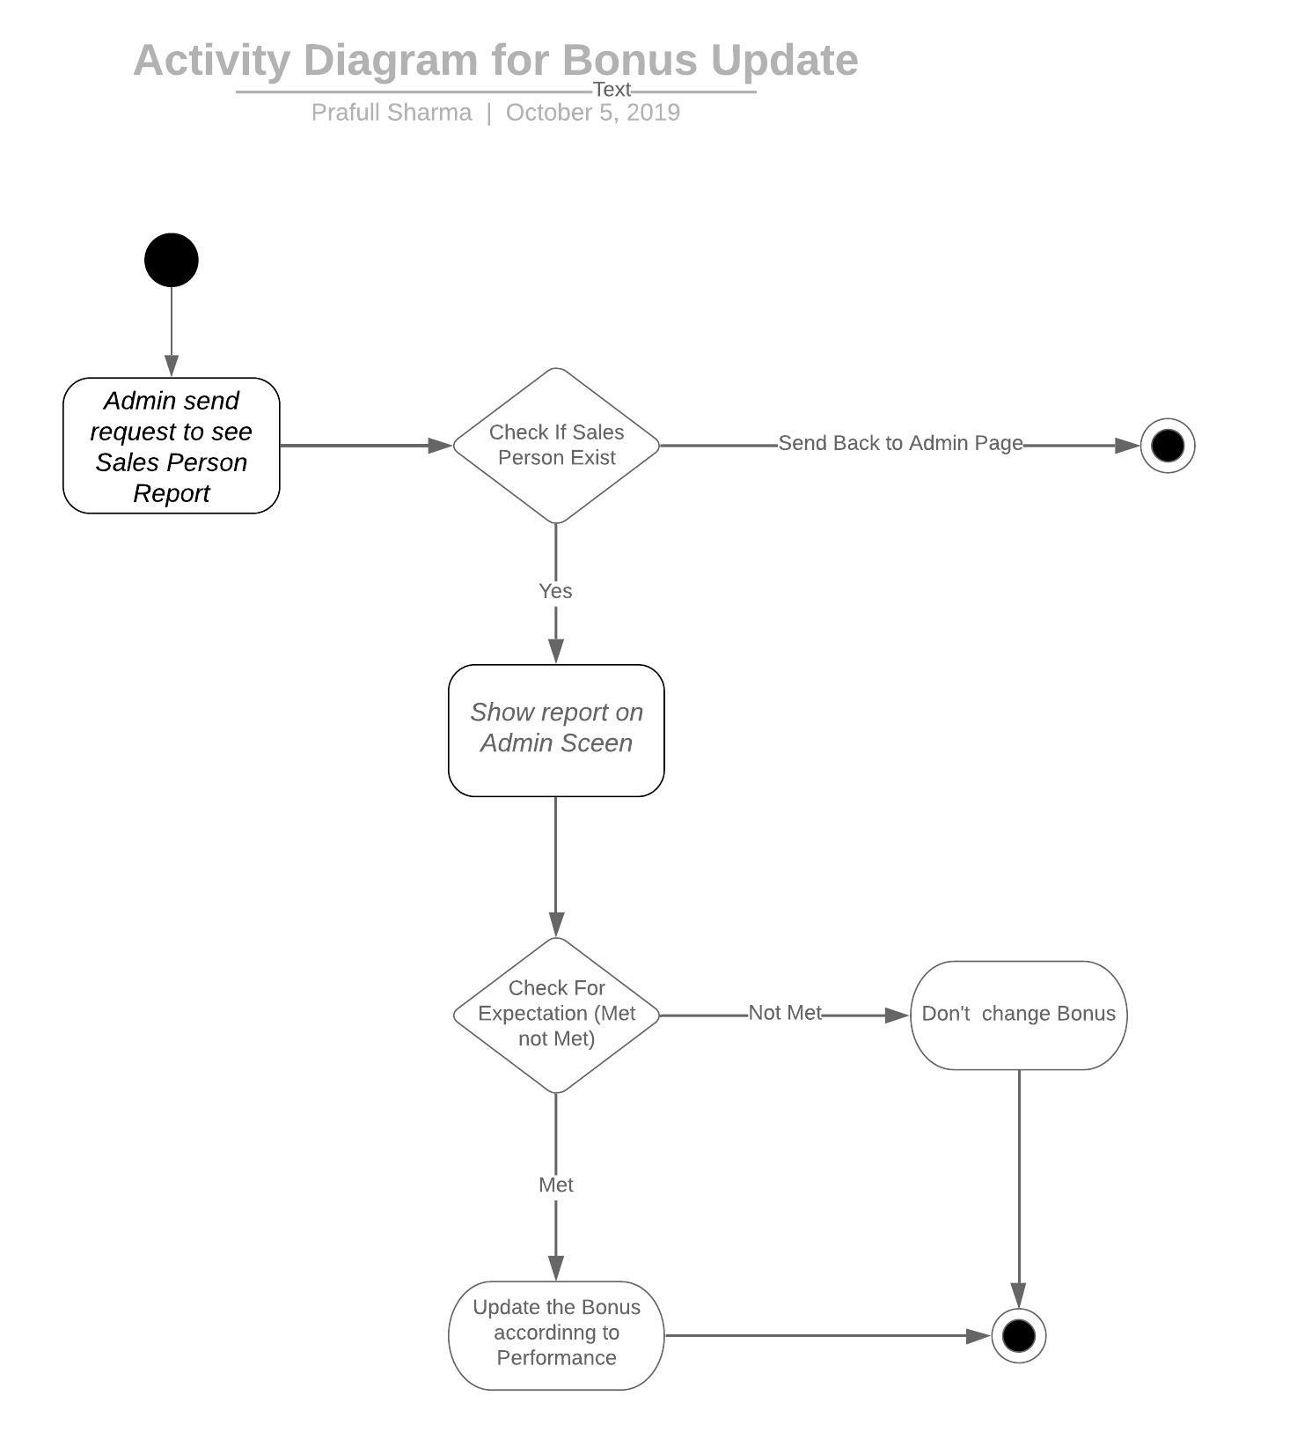
Activity Diagram For Updating Bonus

Slide 21
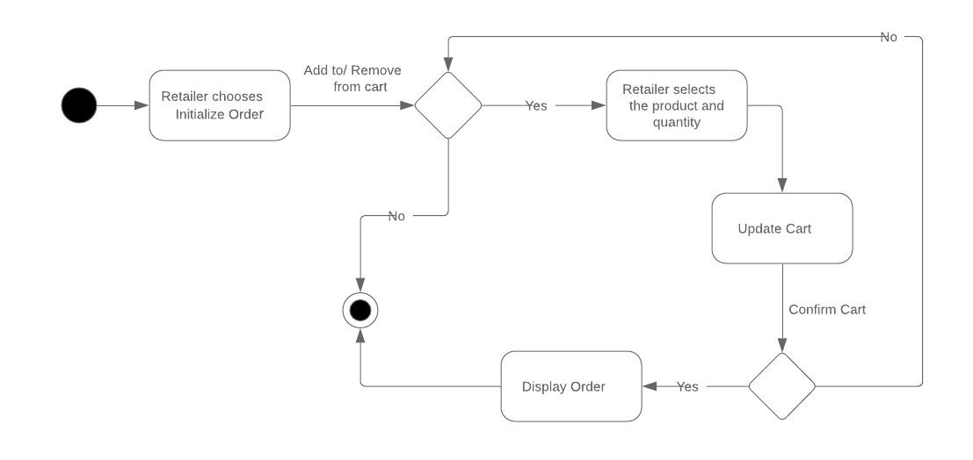
Activity diagram for Order Initializing:

Slide 22
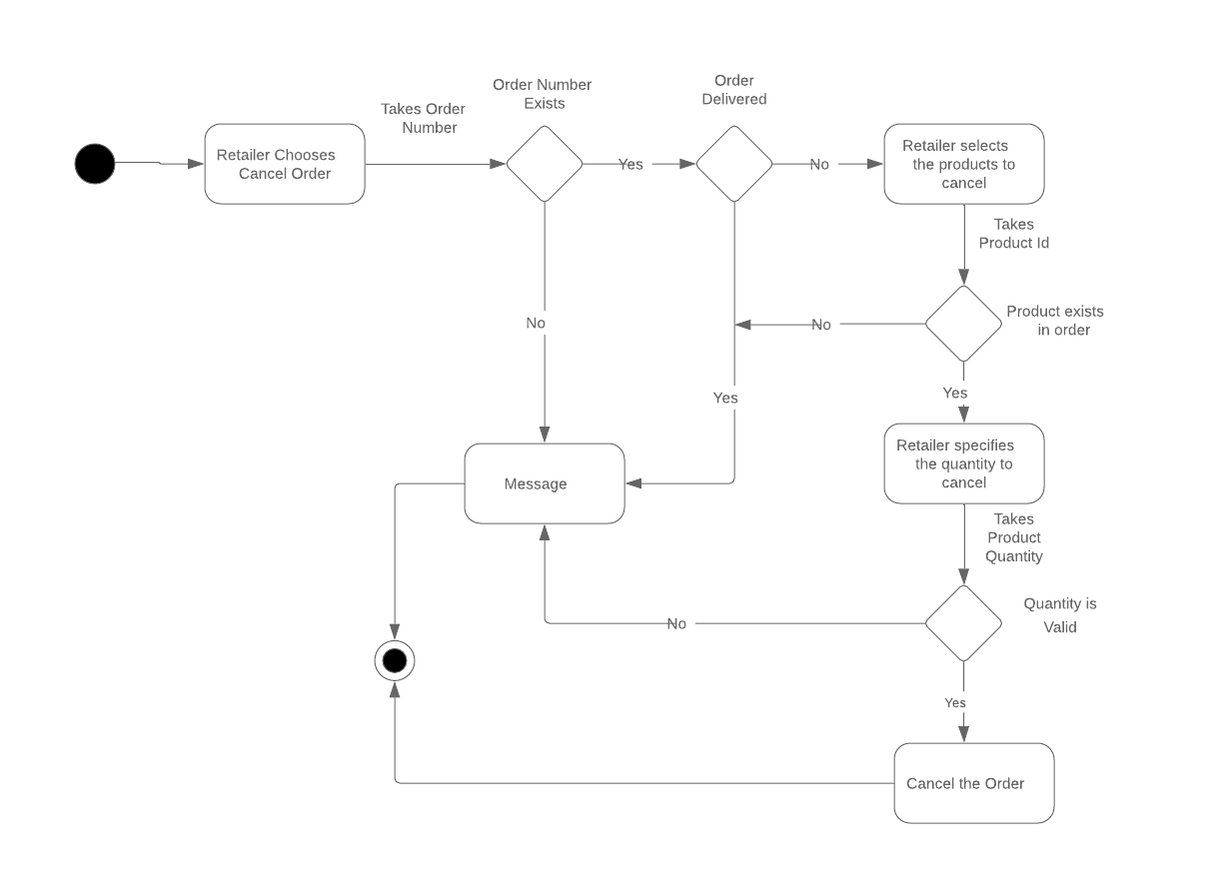
Activity diagram for Order Cancelling:

Slide 23
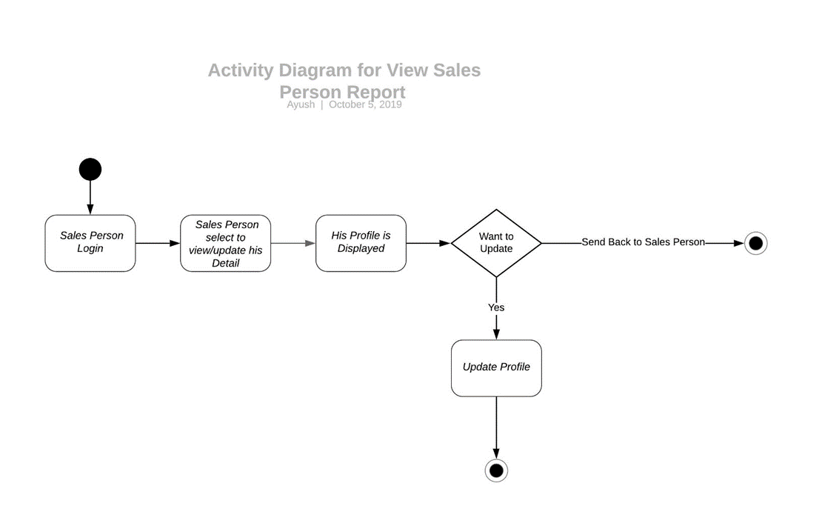
Activity Diagram For Sales Person Detail

Slide 24
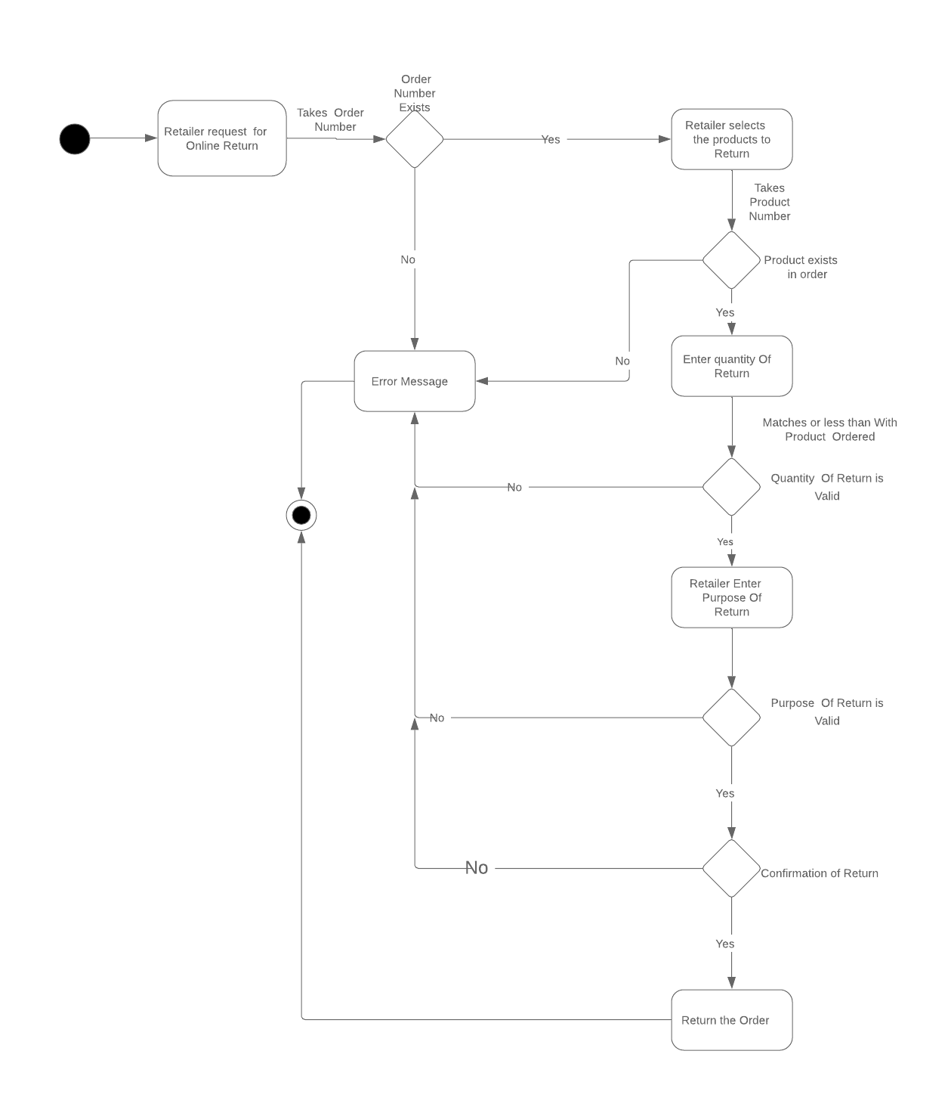
Activity Diagram for Online Return

Slide 25
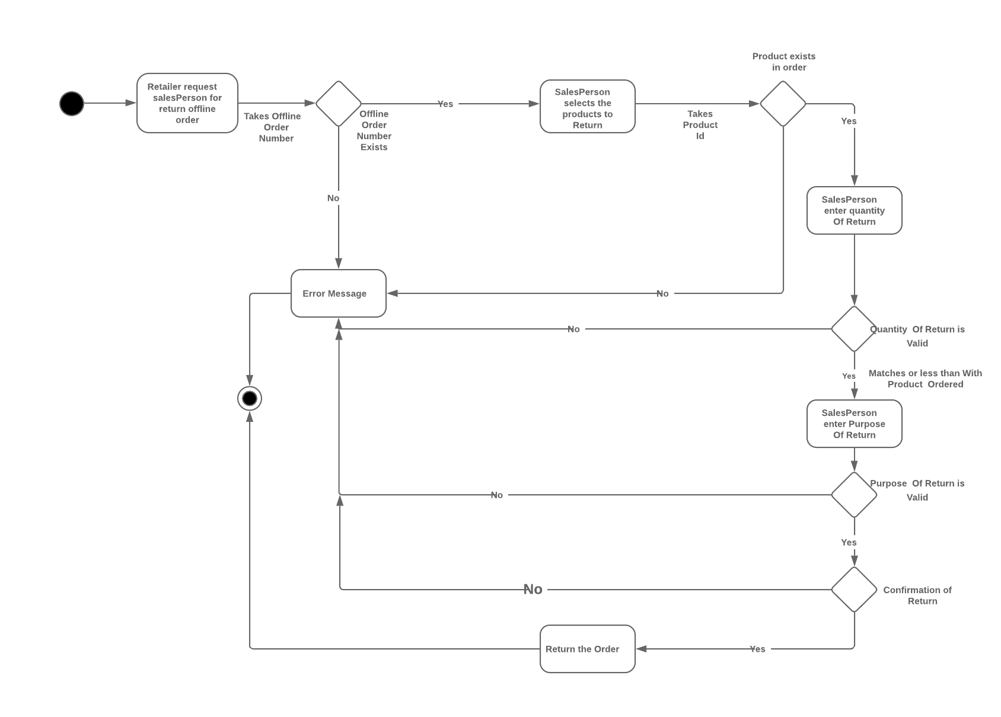
Activity Diagram for Offline Return

